Slide 1
Kitchen-Terraform
An introduction to testing Terraform configuration
using Google’s network module

Slide 2
Requirements
Terraform executable on path
Ruby
VSCode (Optional)

Slide 3
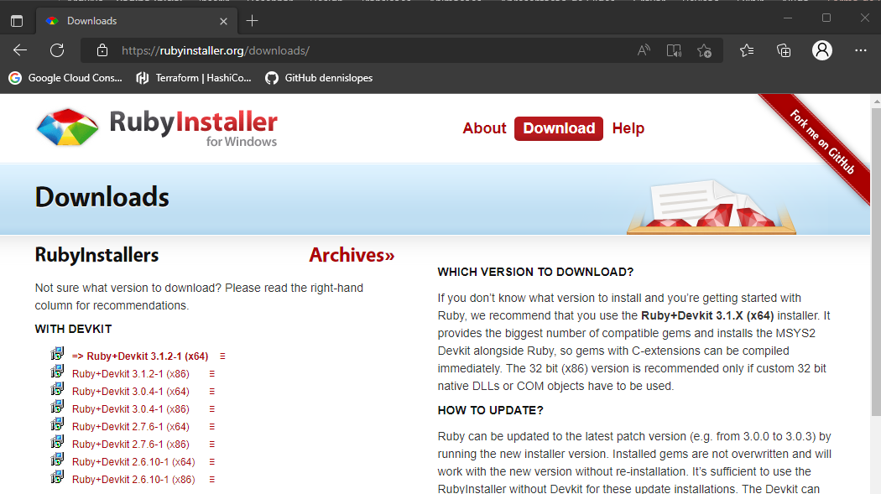
Installing Ruby (Windows)
Downloads (rubyinstaller.org)

Slide 4
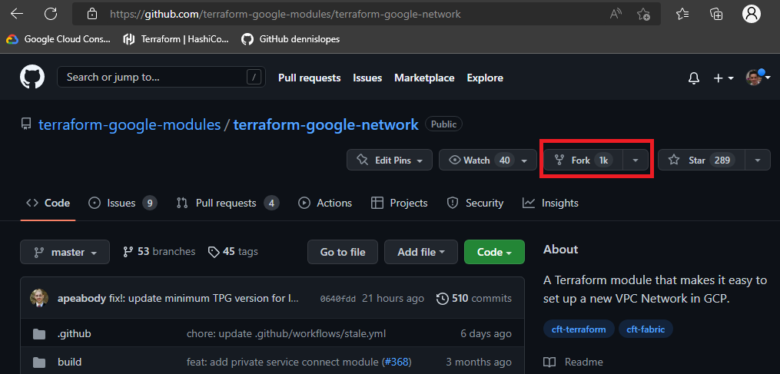
Forking Terraform Network Module
terraform-google-modules/terraform-google-network

Slide 5
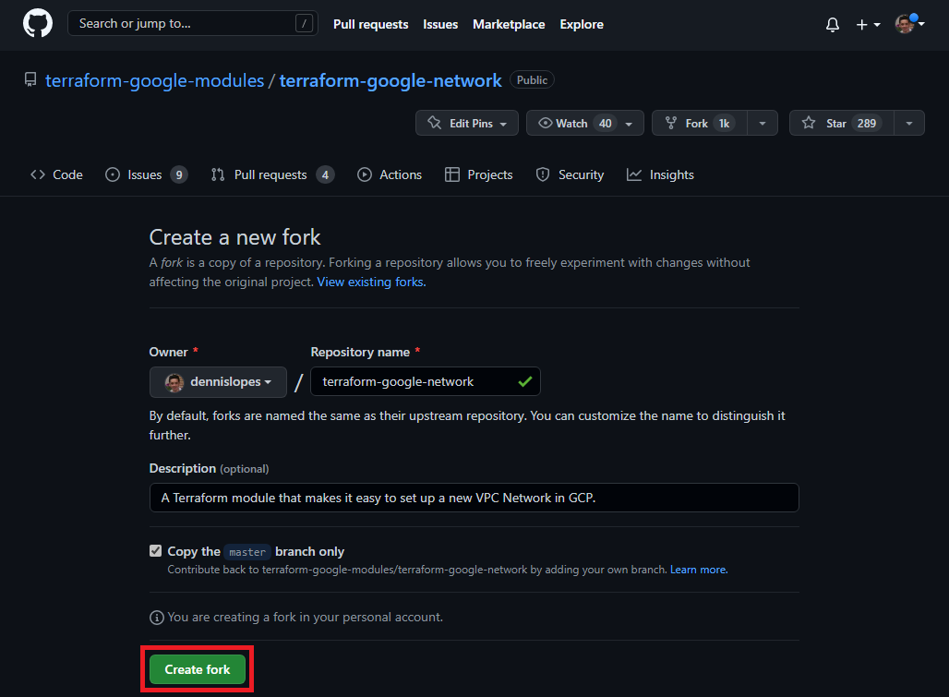
Forking Terraform Network Module

Slide 6
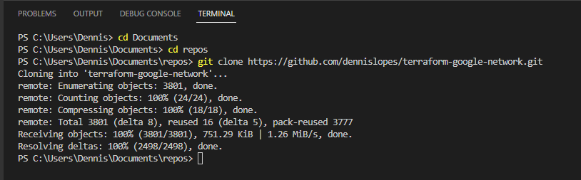
Cloning repository locally
git clone https://github.com/dennislopes/terraform-google-network.git

Slide 7
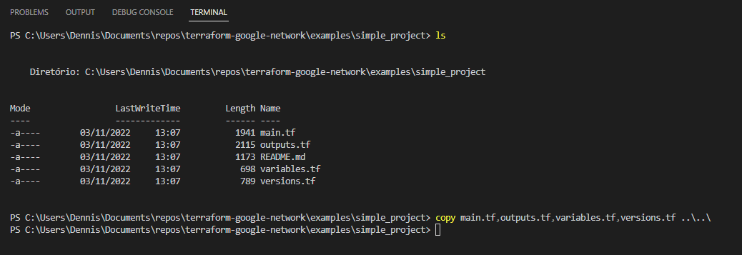
Copying simple_project example to main folder
copy main.tf,outputs.tf,variables.tf,versions.tf ..\..\

Slide 8
Creating the Kitchen Project
On the root of the repository, run:
mkdir -p test/integration/kt_suite/controls
mkdir -p test/fixtures/tf_module

Slide 9
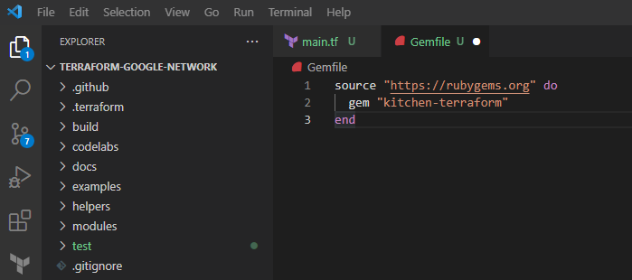
Specifying kitchen libraries
On the root of the repository create a Gemfile:
source "https://rubygems.org" do
gem "kitchen-terraform"
end

Slide 10
Installing kitchen libraries
On the root of the repository, run:
gem install bundler
bundle install

Slide 11
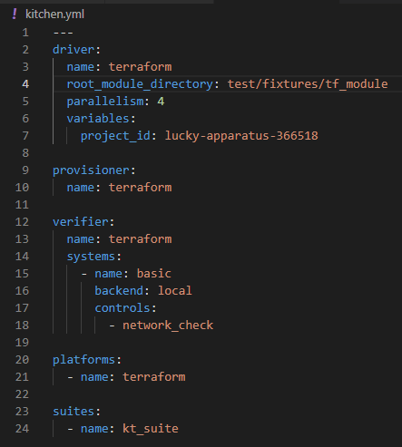
Creating a kitchen configuration file
On the root of the repository create a kitchen.yml file:

Slide 12

Creating the tfvars file
On the root of the repository create a terraform.tfvars file and fill the project_id:
project_id = "lucky-apparatus-366518"

Slide 13
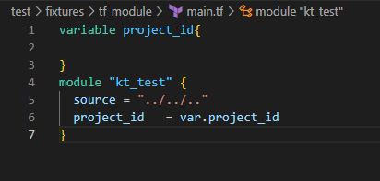
Creating terraform fixture code
On the /test/fixtures/tf_module/ folder, create the main.tf with the code below:
variable project_id{
}
module "kt_test" {
source = "../../.."
project_id = var.project_id
}

Slide 14
Apply the fixture Terraform module config.
bundle exec kitchen converge

Slide 15
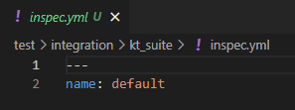
Creating default profile
On the /test/integration/kt_suite folder, create the inspec.yml file with the code below:
---
name: default

Slide 16
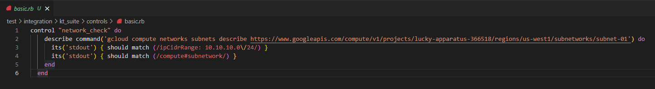
Creating inspec control test file
On the /test/integration/kt_suite/controls folder, create the basic.rb file with the code below:
control "network_check" do
describe command('gcloud compute networks subnets describe https://www.googleapis.com/compute/v1/projects/lucky-apparatus-366518/regions/us-west1/subnetworks/subnet-01') do
its('stdout') { should match (/ipCidrRange: 10.10.10.0\/24/) }
its('stdout') { should match (/compute#subnetwork/) }
end
end

Slide 17
Run inspec control tests
bundle exec kitchen verify

Slide 18
Destroy the configuration
bundle exec kitchen destroy

